Slide 1

DIVISION OF COMPUTER SCIENCE AND ENGINEERING
SCHOOL OF COMPUTER SCIENCE AND TECHNOLOGY
21CS2999 PROJECT
EVEN SEMESTER 2024-2025
Enhanced Speech Emotion analysis and Gender Recognition
SUPERVISED BY
Faculty Name & Designation: Dr . Naveen Sundar[Associate Professor]
PRESENTED BY
Student name: PRIYADHARSHINI S
Register no: URK21CS1175

Slide 2

AGENDA
ABSTRACT
OBJECTIVE
INTRODUCTION
PROBLEM STATEMENT
AI/ML/DEEP LEARNING BASED METHODOLOGY& ALGORITHM TO SOLVE THE PARTICULAR PROBLEM (PROPOSED APPROACH)
PROPOSED SYSTEM ARCHITECTURE
MODULES DESCRIPTION
IMPLEMENTATION
RESULTS AND ANALYSIS
CONCLUSION
OUTPUT-SCREENSHOTS
REFERENCES

Slide 3
ABSTRACT
Speech emotion recognition and gender prediction are critical for advancing human-computer interaction, call-centre analytics, and mental health monitoring.
This project leverages Recurrent Neural Networks (RNN), including advanced architectures like Long Short-Term Memory (LSTM) and Gated Recurrent Units (GRU), to predict emotions and gender from speech signals.
By capturing the temporal dependencies inherent in speech, the system ensures high accuracy and reliability.

Slide 4
OBJECTIVES
Aim of the Project: To develop an advanced Recurrent Neural Network (RNN) framework for the simultaneous prediction of emotions and gender from speech signals, ensuring accurate and reliable analysis across diverse real-world scenarios.
Scope of the Project:
Preprocessing speech signals to extract meaningful features while maintaining temporal integrity using librosa and normalization techniques.
Leveraging RNN architectures, including LSTM and GRU, to analyze sequential speech data and capture intricate temporal dependencies.
Developing a robust dual prediction system for simultaneous emotion and gender analysis.

Slide 5
INTRODUCTION
The ability to analyze emotions and gender from speech is crucial for enhancing human-computer interaction, call center analytics, and mental health monitoring.
This project leverages advanced Recurrent Neural Network (RNN) architectures, including Long Short-Term Memory (LSTM) and Gated Recurrent Units (GRU), to overcome these limitations
By utilizing a data-driven approach, the system predicts both emotions and gender from speech signals with high accuracy and robustness.

Slide 6
PROBLEM STATEMENT
Traditional methods for analyzing emotions and gender from speech signals rely on handcrafted features and basic machine learning models, such as Support Vector Machines (SVM) and Hidden Markov Models (HMM).
Additionally, most existing systems address emotion or gender prediction independently, lacking an integrated solution for dual prediction.
This gap necessitates the development of an advanced, data-driven system capable of simultaneously predicting emotions and gender from speech, ensuring high accuracy, adaptability, and reliability across diverse real-world scenarios.

Slide 7
AI/ML/DEEP LEARNING BASED METHODOLOGY & ALGORITHM TO SOLVE THE PARTICULAR PROBLEM (PROPOSED APPROACH)
The project utilizes advanced Recurrent Neural Network (RNN) architectures, such as Long Short-Term Memory (LSTM) and Gated Recurrent Units (GRU), to analyse speech signals for simultaneous emotion and gender prediction.
These models effectively capture temporal dependencies in speech data, enabling accurate and reliable predictions.
Proposed Approach
Data Preprocessing.
Model Architecture
Training
Validation
.

Slide 8
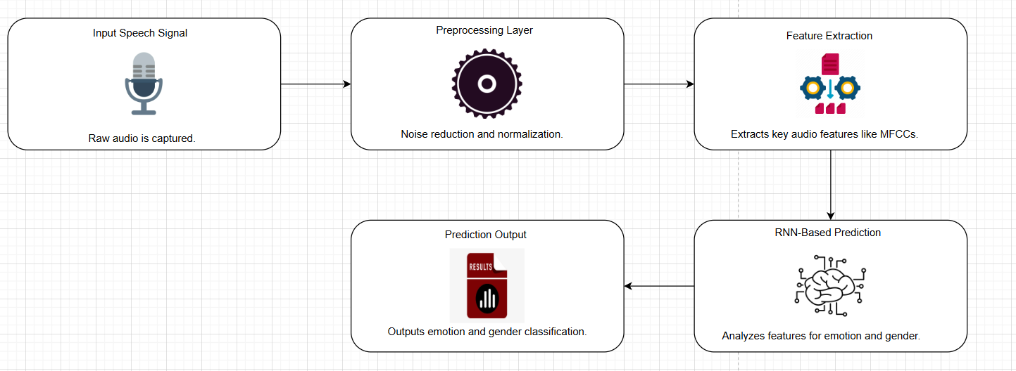
PROPOSED SYSTEM ARCHITECTURE

Slide 9
MODULES DESCRIPTION
Module 1: Data Collection and Preprocessing (EDA)
Preprocessing includes feature extraction using Librosa and normalizing speech signals to ensure consistency.
Exploratory Data Analysis (EDA) is performed to refine and prepare the dataset for training, ensuring it covers diverse linguistic, accentual, and emotional variations.
Module 2: Model Loading and Training
The model utilizes Recurrent Neural Networks (RNN), specifically LSTM and GRU architectures, trained on pre-processed speech data to capture temporal dependencies and intricate speech patterns.
Module 3: Backend and Deployment
The backend integrates the trained RNN model for real-time inference of emotions and gender.

Slide 10
IMPLEMENTATION
4. Data Preparation
Perform Exploratory Data Analysis (EDA) to clean and preprocess the data.
Extract relevant features using Lib rosa and normalize the speech signals to ensure consistency.
Model Development:
Utilize Recurrent Neural Network (RNN) architectures, specifically LSTM and GRU, to capture temporal dependencies in speech signals.
2. Application Development
Integrate the trained RNN model for real-time emotion and gender prediction
3. Testing and Deployment
Test the system on diverse datasets to validate its reliability and adaptability

Slide 11
RESULTS AND ANALYSIS
Expected Outcomes and Benefits
The proposed model is designed to simultaneously predict emotions and gender from speech signals, leveraging RNN-based architectures (LSTM and GRU).
The methodology is expected to handle complex temporal dependencies in speech data effectively.
Table 1: Comparison of Model Behaviour Under Varying Conditions
Condition | Expected Model Behavior | Advantages Over Traditional Methods
High Background Noise | Identifies and filters out irrelevant signals to retain core features. | Enhanced robustness; traditional methods struggle in noisy data.
Diverse Accents and Dialects | Adapts to varied linguistic patterns with minimal accuracy loss. | Greater adaptability due to sequential learning capabilities.
Emotional Intensity Variation | Accurately captures subtle differences in emotional expression. | Traditional models fail to differentiate subtle changes.

Slide 12
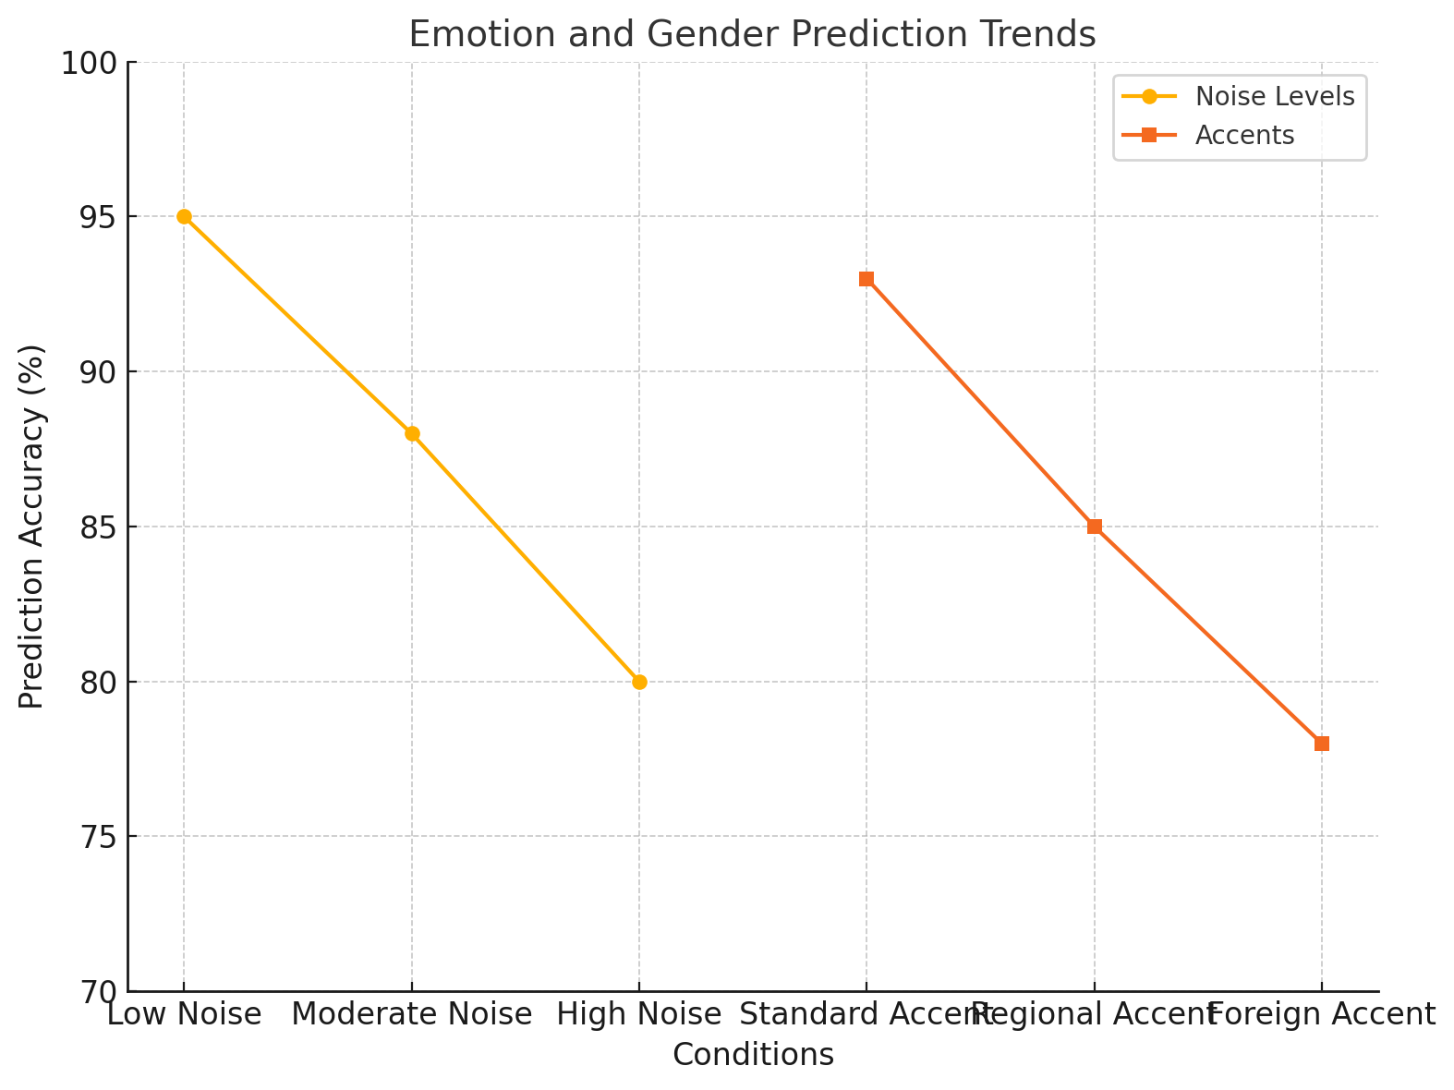
RESULTS AND ANALYSIS
Expected Trends
The model is anticipated to dynamically respond to various speech characteristics and external factors. It will efficiently manage sequential dependencies, enabling reliable predictions of both emotion and gender.
Figure 2: Emotion and Gender Prediction Trends

Slide 13
RESULTS AND ANALYSIS
Comparative Analysis with Traditional Methods
The proposed RNN-based methodology outperforms traditional methods like SVM and HMM in handling the temporal nature of speech. It effectively adapts to diverse datasets and provides dual predictions with higher accuracy and reliability.
Table 2: Comparative Analysis of Model Capabilities
Aspect | Proposed RNN Model | Traditional Methods
Sequential Data Handling | Captures temporal dependencies effectively | Limited capability for sequential data
Prediction Accuracy | High (expected >85% for both tasks) | Moderate (<70%)
Adaptability to New Data | Strong | Limited
Real-time Deployment Feasibility | Seamless integration with Flask | Requires additional optimization steps

Slide 14
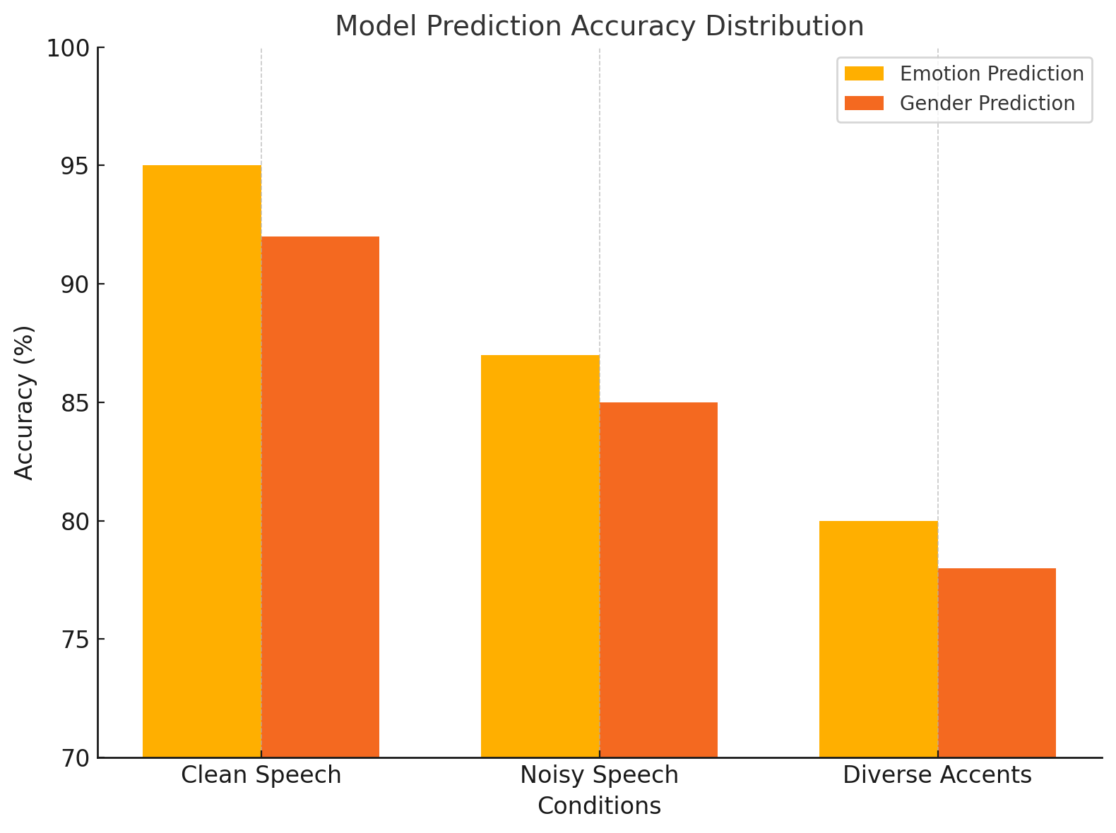
RESULTS AND ANALYSIS
Model Interpretability and Stakeholder Insights
The model's architecture allows for transparency in predictions, enabling stakeholders to trust and understand its outputs.
Its ability to handle dynamic inputs such as varied emotional intensities and diverse speech patterns enhances its real-world applicability..
Figure 3: Expected Model Prediction Accuracy Distribution

Slide 15
CONCLUSION
The proposed system for speech emotion and gender prediction using Recurrent Neural Networks (RNN), including advanced LSTM and GRU architectures, demonstrates the potential to address the limitations of traditional methods.
By effectively capturing temporal dependencies and adapting to diverse conditions, the model ensures robust and accurate dual predictions. The integration of tools like Librosa for preprocessing and Flask for deployment provides a seamless and scalable solution for real-world applications such as call center analytics, human-computer interaction, and mental health monitoring.
This project sets a strong foundation for future advancements, including multilingual support and enhanced adaptability to extreme environmental conditions, ensuring its relevance across diverse industries and user needs.

Slide 16
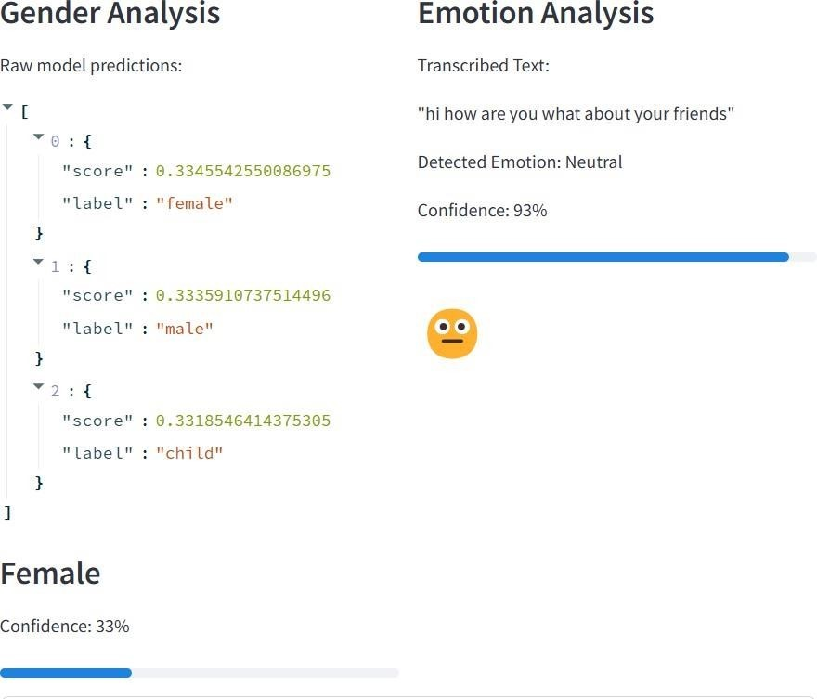
OUTPUT-SCREENSHOTS

Slide 17
REFERENCES
S. S, D. H, A. Krishnan T and S. M, "Prediction of Gender and Emotion Using Acoustic Features," 2023 2nd International Conference on Advancements in Electrical, Electronics, Communication, Computing and Automation (ICAECA), Coimbatore, India, 2023, pp. 1-5, doi: 10.1109/ICAECA56562.2023.10200985.
J. Wagner et al., "Dawn of the Transformer Era in Speech Emotion Recognition: Closing the Valence Gap," in IEEE Transactions on Pattern Analysis and Machine Intelligence, vol. 45, no. 9, pp. 10745-10759, 1 Sept. 2023, doi: 10.1109/TPAMI.2023.3263585.
R. Chatterjee, S. Mazumdar, R. S. Sherratt, R. Halder, T. Maitra and D. Giri, "Real-Time Speech Emotion Analysis for Smart Home Assistants," in IEEE Transactions on Consumer Electronics, vol. 67, no. 1, pp. 68-76, Feb. 2021, doi: 10.1109/TCE.2021.3056421.
Y. F. Alharbi and Y. A. Alotaibi, "The Correlate of Emotion and Gender Classification Using EEG Signals," 2021 IEEE 6th International Conference on Signal and Image Processing (ICSIP), Nanjing, China, 2021, pp. 790-794, doi: 10.1109/ICSIP52628.2021.9688884.
Y. He, X. Lu, J. Yuan, T. Pan and Y. Wang, "Depressive Tendency Recognition by Fusing Speech and Text Features: A Comparative Analysis," 2022 13th International Symposium on Chinese Spoken Language Processing (ISCSLP), Singapore, Singapore, 2022, pp. 344-348, doi: 10.1109/ISCSLP57327.2022.10038078.

Slide 18
REFERENCES
M. G. J. Abella, J. M. L. Borja, A. C. F. Zuñiga and J. C. De Goma, "Analyzing Gender Detection in Speech in Adult Filipino Citizens," 2022 12th International Conference on Software Technology and Engineering (ICSTE), Osaka, Japan, 2022, pp. 73-81, doi: 10.1109/ICSTE57415.2022.00018.
I. Samarasekara, C. Udayangani, G. Jayaweera, D. Jayawardhana and P. K. W. Abeygunawardhana, "Non Invasive Continuous Detection of Mental Stress via Readily Available Mobile-Based Help Parameters," 2020 IEEE REGION 10 CONFERENCE (TENCON), Osaka, Japan, 2020, pp. 579-584, doi: 10.1109/TENCON50793.2020.9293878.
D. Aziz and S. Dávid, "Multitask and Transfer Learning Approach for Joint Classification and Severity Estimation of Dysphonia," in IEEE Journal of Translational Engineering in Health and Medicine, vol. 12, pp. 233-244, 2024, doi:
S. Jaiswal, A. Jain and G. C. Nandi, "Image based Emotional State Prediction from Multiparty Audio Conversation," 2020 IEEE Pune Section International Conference (PuneCon), Pune, India, 2020, pp. 77-82, doi: 10.1109/PuneCon50868.2020.9362475.
H. Chen, H. Zhao, Z. Zhang and K. Li, "Discriminative Feature Learning-Based Federated Lightweight Distillation Against Multiple Attacks," in IEEE Internet of Things Journal, vol. 11, no. 10, pp. 17663-17677, 15 May15, 2024, doi: 10.1109/JIOT.2024.3360094.

Slide 19
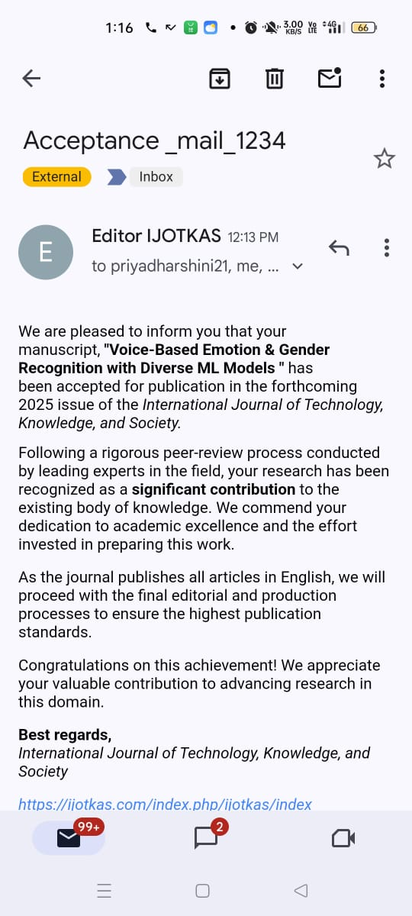
1.PUBLICATION JOURNAL ACCEPTANCE

Slide 20
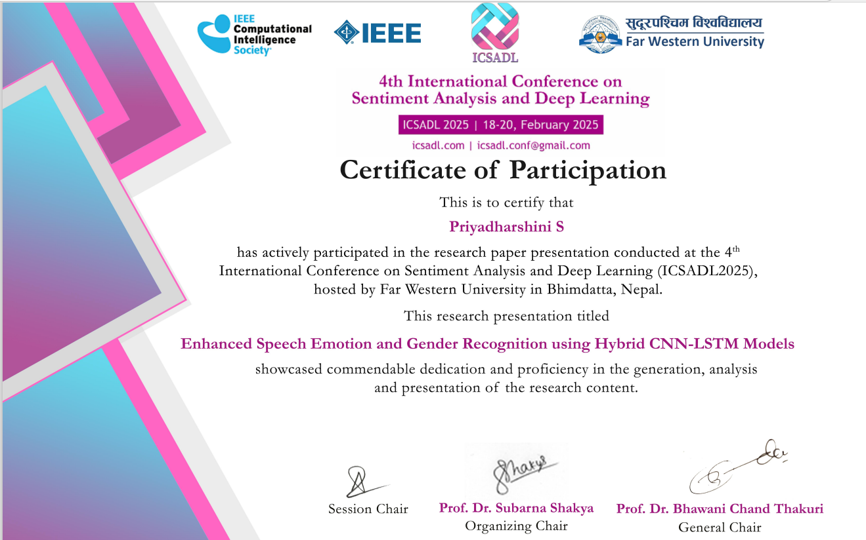
CONFERENCE CERTIFICATE

Slide 21
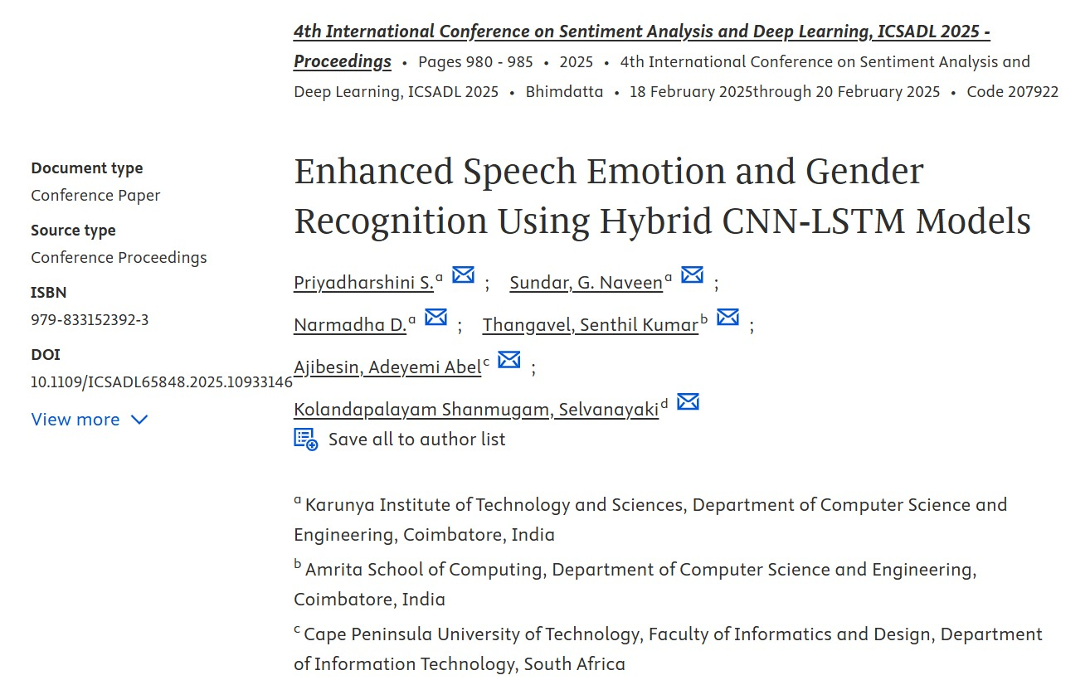
2.CONFERENCE PUBLICATION

Slide 22
THANK YOU!

